Slide 1



Falcon 9: SpaceX First Stage Success Probability
Data Scientist
Maycol Francisco Sánchez Sánchez

Slide 2
Outline
Executive Summary
Table of Contents
Introduction
Methodology
Results
Discussion
Conclusion
Appendix

Slide 3
Executive Summary
Summary Methods
  Data Collection through API
  Data Collection Web Scraping Method
  Data Wrangling Method
  Data Analysis with SQL
  Data Analysis with Data Visualization
  Interactive Visual Analytics with Folium
  Machine Learning Prediction
Summary Final Results
  Exploratory Data Analysis result
  Interactive analytics in screenshots
  Predictive Analytics result

Slide 4
Introduction
In this capstone, we will predict if the Falcon 9 first stage will land successfully. SpaceX advertises Falcon 9 rocket launches on its website, with a cost of 62 million dollars; other providers cost upward of 165 million dollars each, much of the savings is because SpaceX can reuse the first stage. Therefore if we can determine if the first stage will land, we can determine the cost of a launch. This information can be used if an alternate company wants to bid against SpaceX for a rocket launch. In this module, you will be provided with an overview of the problem and the tools you need to complete the course.
Responses to the approaches
  What factors determine if the rocket will land successfully
  The interaction amongst various features that determine the success rate of a successful landing.
  What operating conditions needs to be in place to ensure a successful landing program.

Slide 5
Methodology
Summary Methods
  Jupyter Lab – SpaceX Data Collection Api
  Jupyter Lab – Web Scraping
  Jupyter Lab – Data Wrangling
  Jupyter Lab – EDA SQL sqllite
  Machine Learning Prediction Lab

Slide 6
SpaceX Data Collection
The data was collected using various methods
  Data collection was done using get request to the SpaceX API.
  Next, we decoded the response content as a Json using .json() function call and turn it into a pandas dataframe using .json_normalize().
  We then cleaned the data, checked for missing values and fill in missing values where necessary.
  In addition, we performed web scraping from Wikipedia for Falcon 9 launch records with BeautifulSoup.
  The objective was to extract the launch records as HTML table, parse the table and convert it to a pandas dataframe for future analysis.

Slide 7
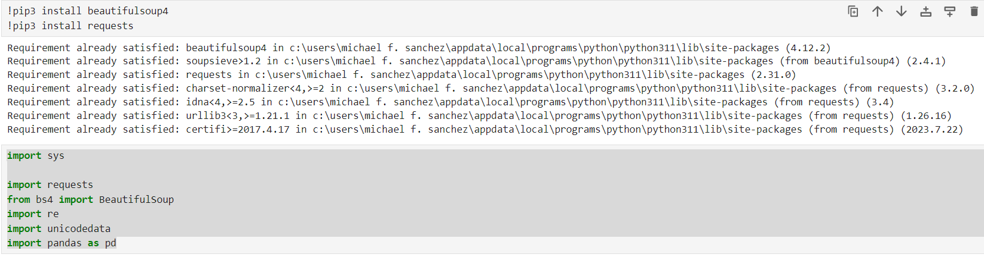
Web Scraping
Web scraping tasks are executed to extract data from web of spacex with beautifulsoup, all tasks were carried out in the jupyter laboratory environment

Slide 8
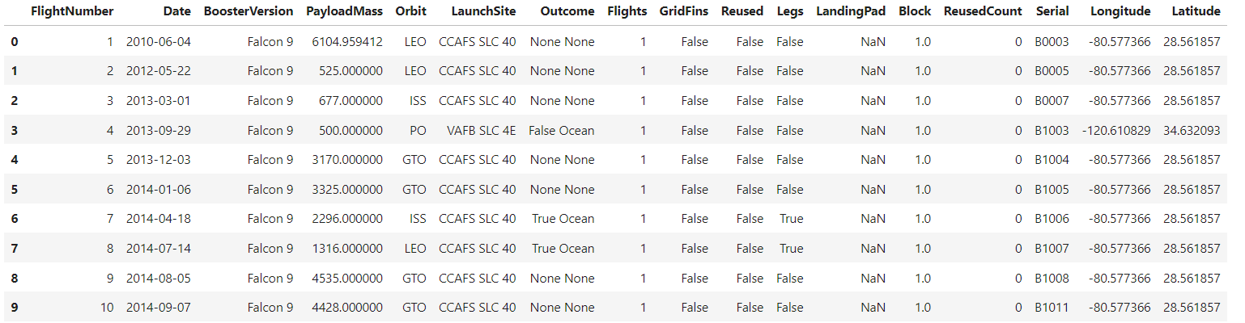

Data Wrangling
The Data Wrangling method was executed to obtain the launch data of the Falcon 9 version, the pandas and numpy libraries were used to obtain ordered, filtered and calculated data.
We calculate the number of LaunchSites using pandas.

Slide 9
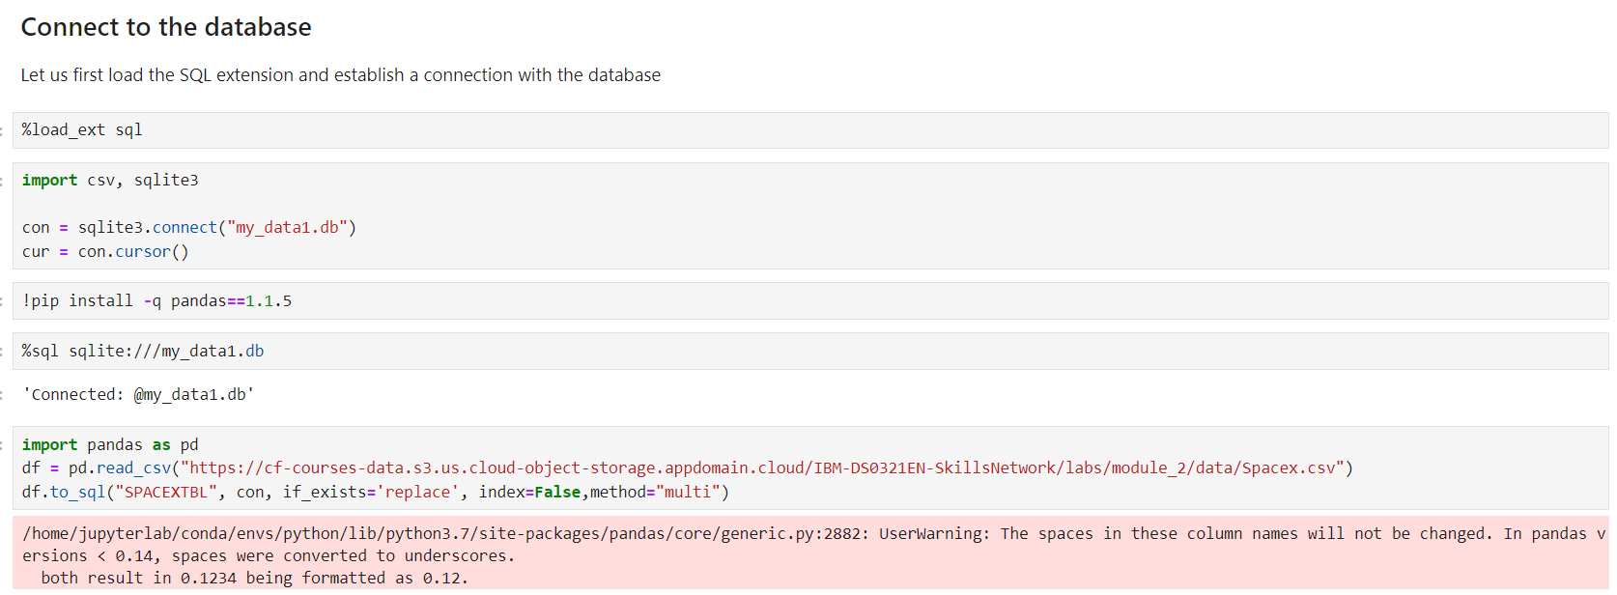
EDA SQL sqllite
Use the library to make a sqlite connection to extract data using a link as a database

Slide 10
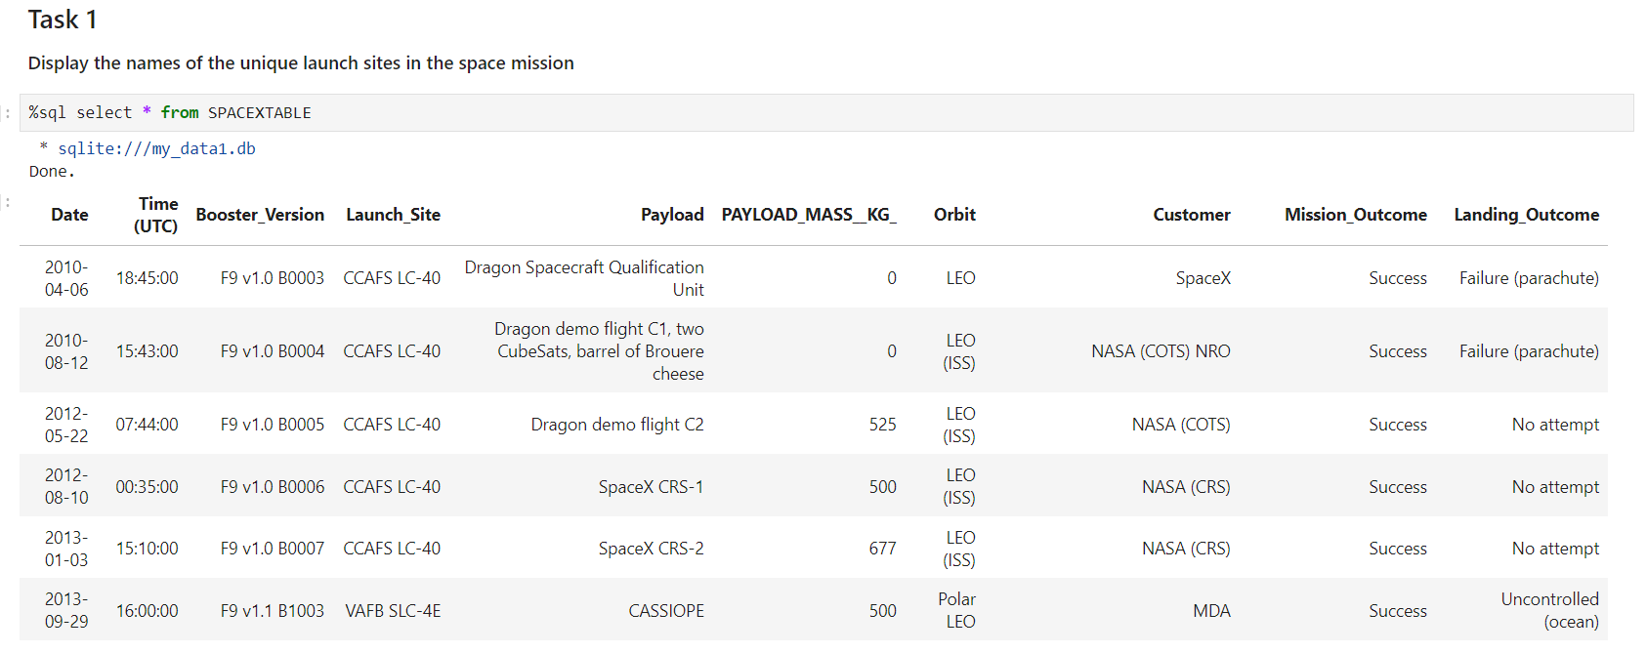
EDA SQL sqllite
As a result of executing the SQL statements, we obtain a dataset to perform the review, filtering and cleaning operations.

Slide 11
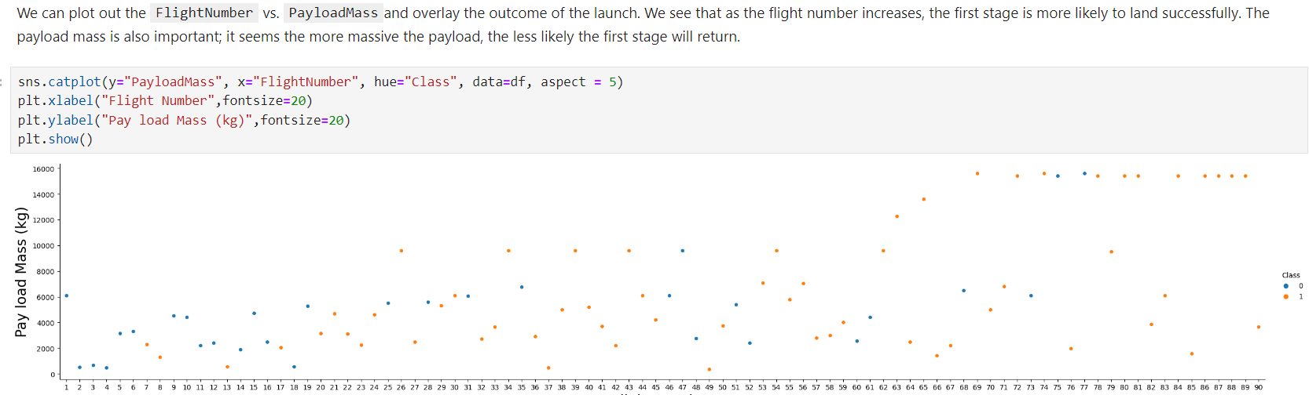
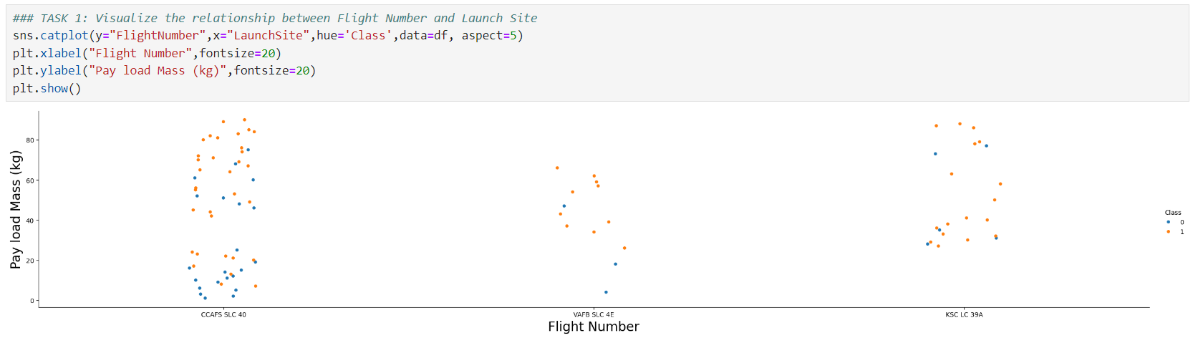
EDA Visualization Data

Slide 12
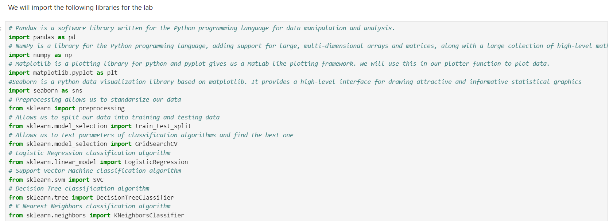
Machine Learning Prediction Lab
Each of the libraries used for data processing such as pandas, numpy, seaborn, sklearn were used and each of the statements were executed to obtain the processing of the data to be processed.

Slide 13
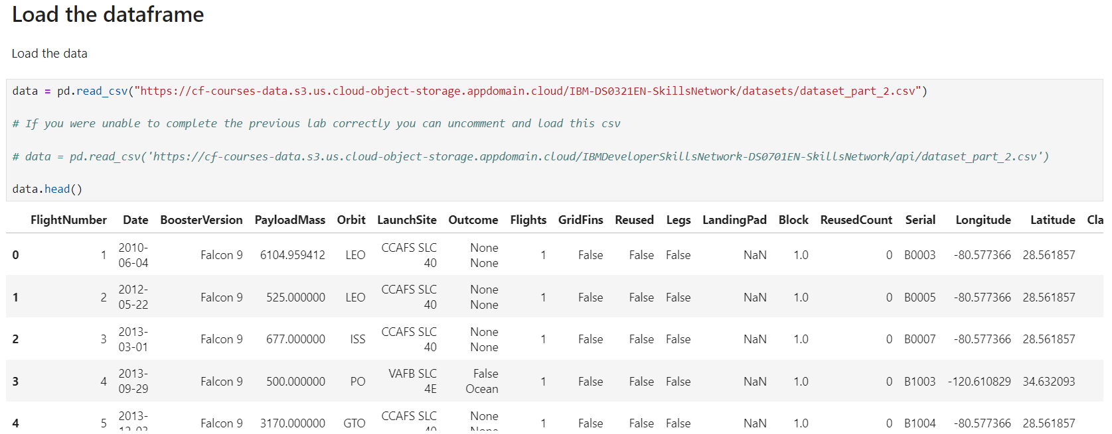
Machine Learning Prediction Lab

Slide 14
Machine Learning Prediction Lab
We loaded the data using numpy and pandas, transformed the data, split our data into training and testing.
We built different machine learning models and tune different hyperparameters using GridSearchCV.
We used accuracy as the metric for our model, improved the model using feature engineering and algorithm tuning.
We found the best performing classification model.

Slide 15
Conclusions
We can conclude that:
The larger the flight amount at a launch site, the greater the success rate at a launch site.
Launch success rate started to increase in 2013 till 2020.
Orbits ES-L1, GEO, HEO, SSO, VLEO had the most success rate.
KSC LC-39A had the most successful launches of any sites.
The Decision tree classifier is the best machine learning algorithm for this task.

